Slide 1
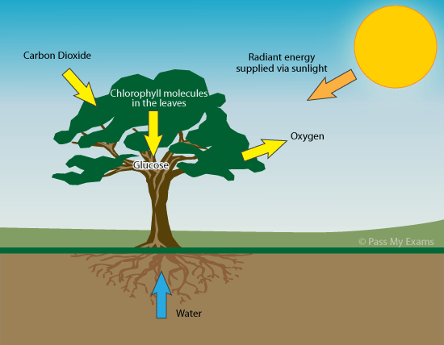
PHOTOSYNTHESIS

Slide 2
The Process That Feeds the Biosphere
Plants and other photosynthetic organisms contain organelles called chloroplasts
Photosynthesis is the process that converts solar energy into chemical energy within chloroplasts
Directly or indirectly, photosynthesis nourishes almost the entire living world

Slide 3
Autotrophs are “self-feeders” that sustain themselves without eating anything derived from other organisms
Autotrophs are the producers of the biosphere, producing organic molecules from CO₂ and other inorganic molecules
Almost all plants are photoautotrophs, using the energy of sunlight to make organic molecules

Slide 4
Heterotrophs obtain organic material from other organisms
Heterotrophs are the consumers of the biosphere
Some eat other living organisms; others, called decomposers, consume dead organic material or feces
Almost all heterotrophs, including humans, depend on photoautotrophs for food and O₂

Slide 5
Concept 11.1: Photosynthesis converts light energy to the chemical energy of food
Chloroplasts are structurally similar to and likely evolved from photosynthetic bacteria
The structural organization of these organelles allows for the chemical reactions of photosynthesis

Slide 6
Chloroplasts: The Sites of Photosynthesis in Plants
Leaves are the major locations of photosynthesis in plants
Chloroplasts are found mainly in cells of the mesophyll, the interior tissue of the leaf
Each mesophyll cell contains 30–40 chloroplasts
CO₂ enters and O₂ exits the leaf through microscopic pores called stomata

Slide 7
A chloroplast has an envelope of two membranes surrounding a dense fluid called the stroma
Thylakoids are connected sacs in the chloroplast that compose a third membrane system
Thylakoids may be stacked in columns called grana
Chlorophyll, the pigment that gives leaves their green color, resides in the thylakoid membranes

Slide 8
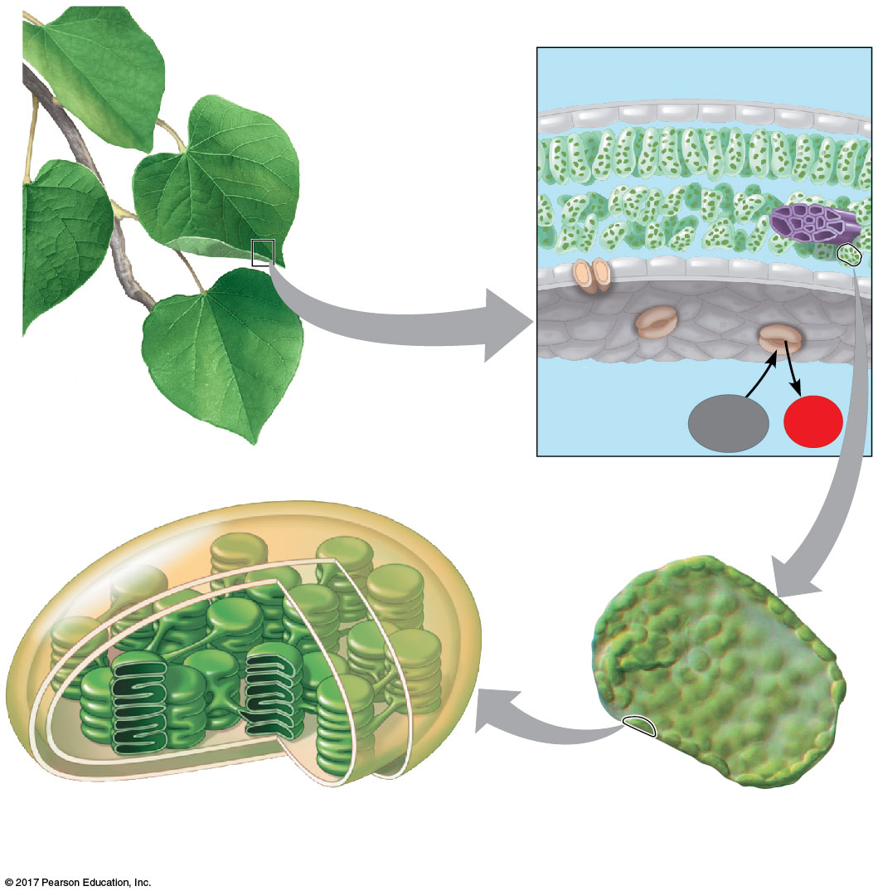
Figure 11.4a
Leaf cross section
Chloroplasts
Vein
Mesophyll
Stomata
CO₂
O₂
Chloroplast
Mesophyll
cell
20 µm
© 2018 Pearson Education Ltd.
Notes:
Figure 11.4a Zooming in on the location of photosynthesis in a plant (part 1: detail of art)

Slide 9
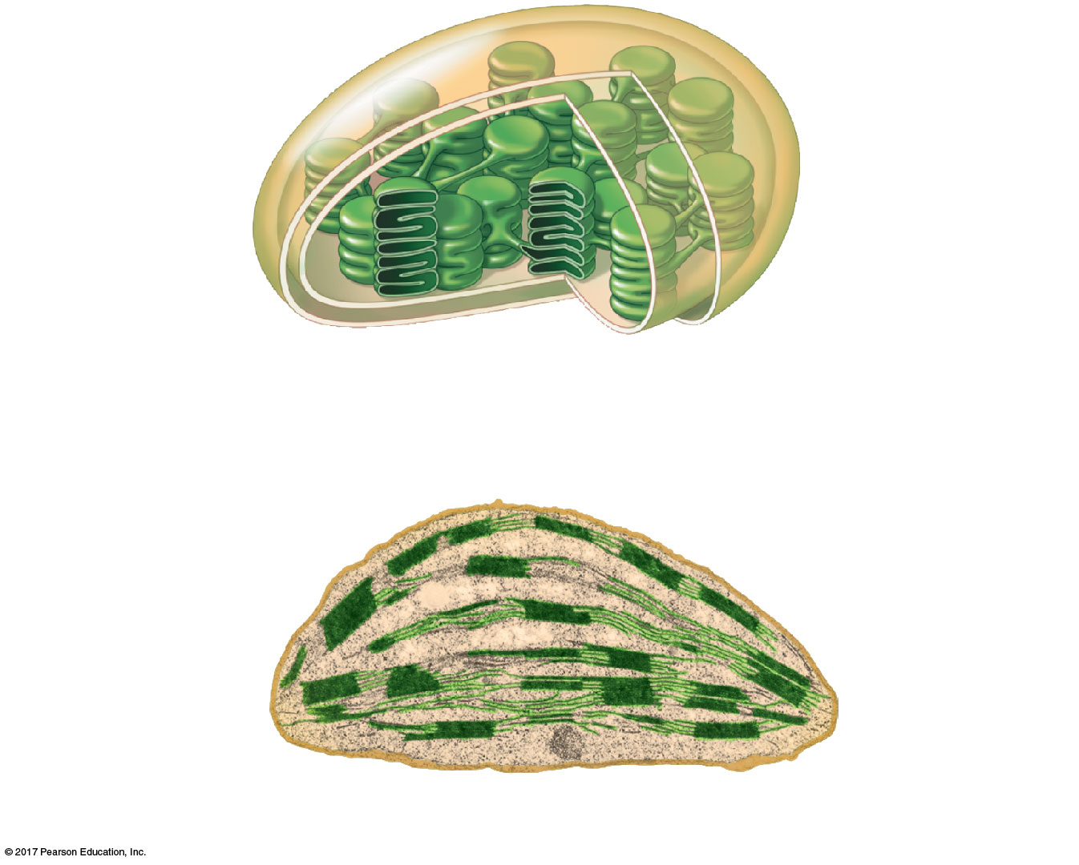
Figure 11.4b
Outer
membrane
Thylakoid
Thylakoid
space
Intermembrane
space
Stroma
Granum
Inner
membrane
Chloroplast
1 µm
© 2018 Pearson Education Ltd.
Notes:
Figure 11.4b Zooming in on the location of photosynthesis in a plant (part 2: chloroplast)

Slide 10
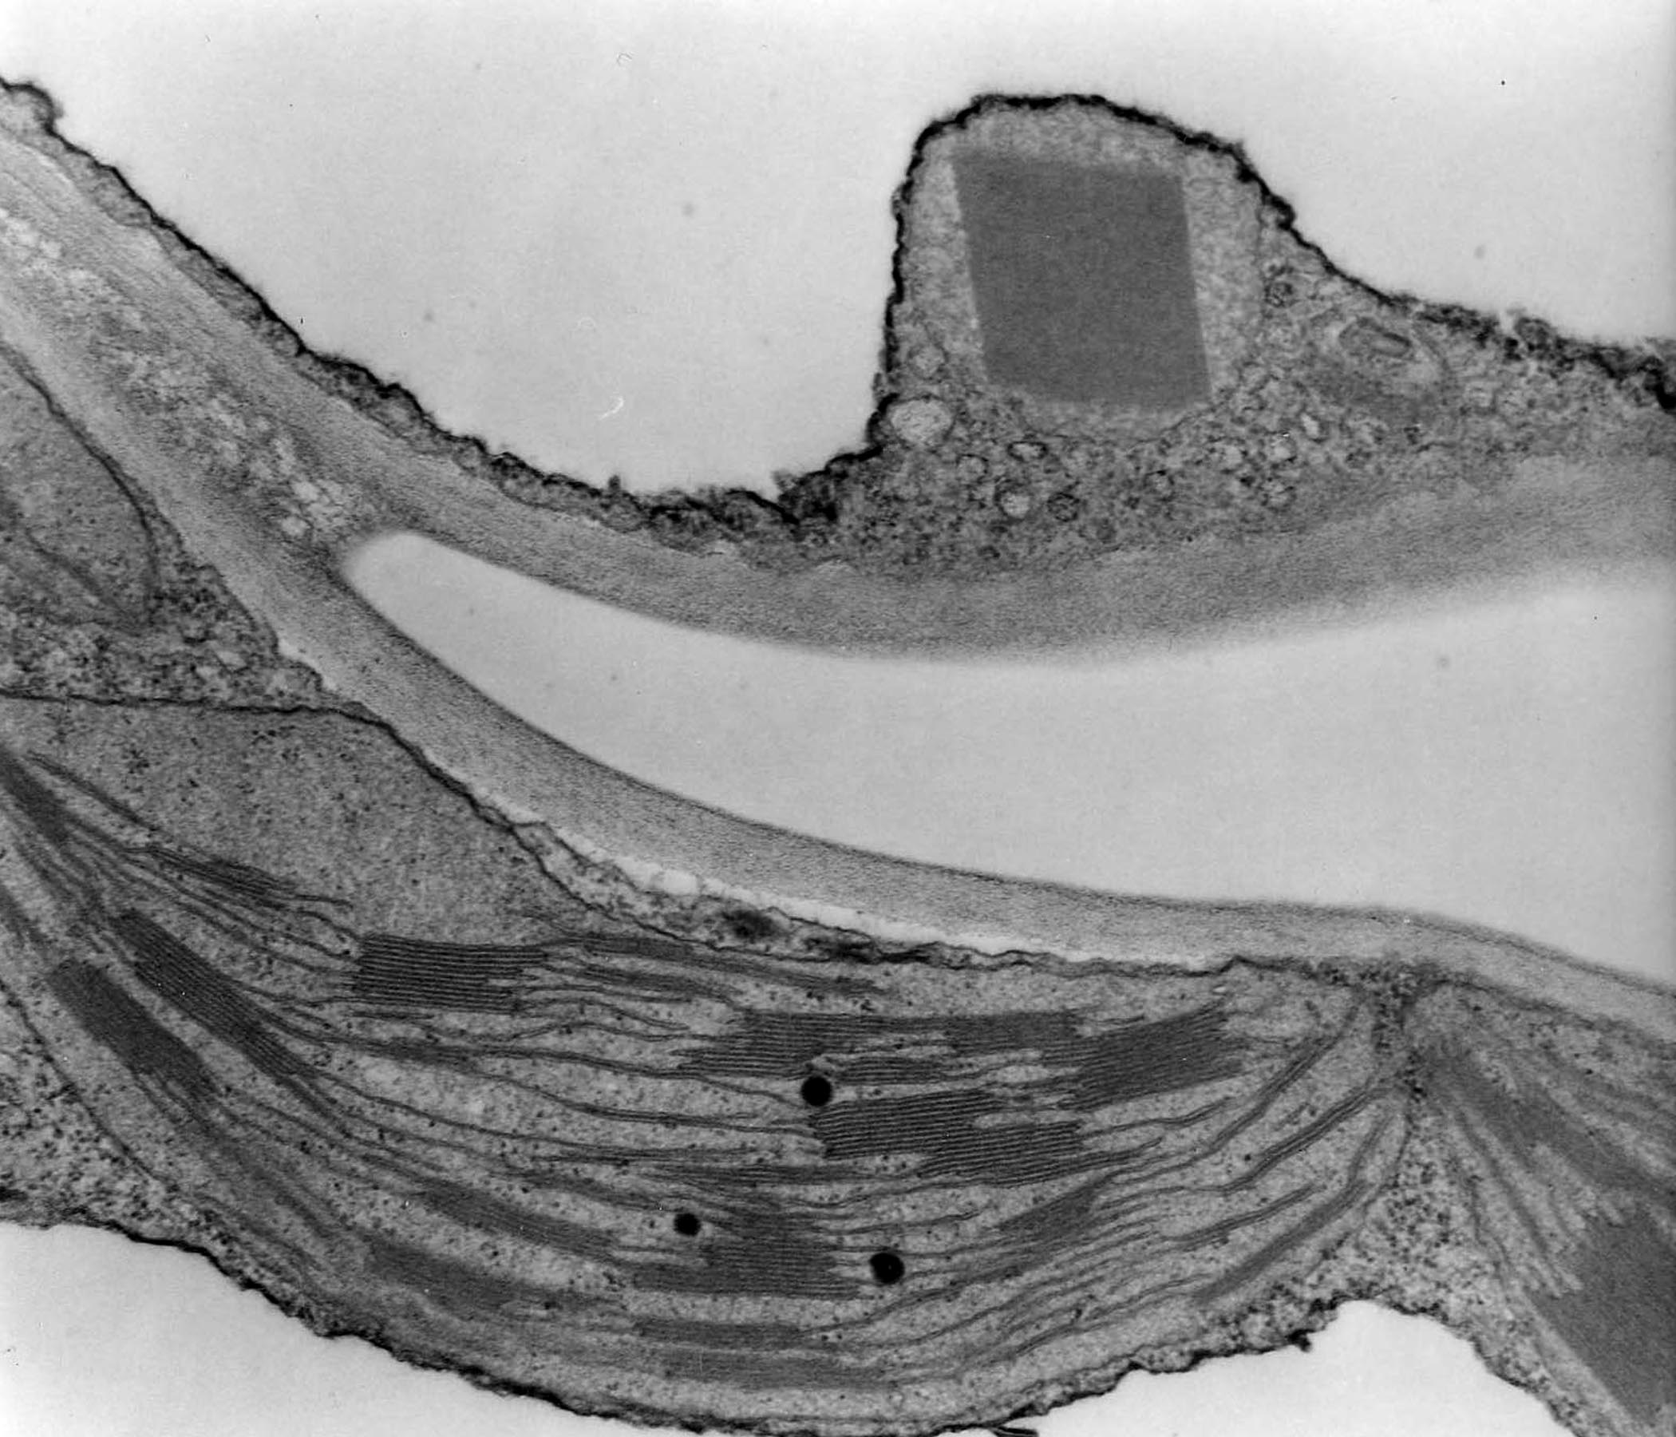
Alkhatib R. et al. Biologia Plantarum 60 (4): 706-714. (DIO:10.1007/s10535-016-0600-z).

Slide 11
Tracking Atoms Through Photosynthesis: Scientific Inquiry
Photosynthesis is a complex series of reactions that can be summarized as the following equation:
6 CO₂ + 12 H₂O + Light energy → C₆H₁₂O₆ + 6 O₂ + 6 H₂O
The overall chemical change during photosynthesis is the reverse of the one that occurs during cellular respiration

Slide 12
The Splitting of Water
Chloroplasts split H₂O into hydrogen and oxygen, incorporating the electrons of hydrogen into sugar molecules and releasing oxygen as a by-product

Slide 13
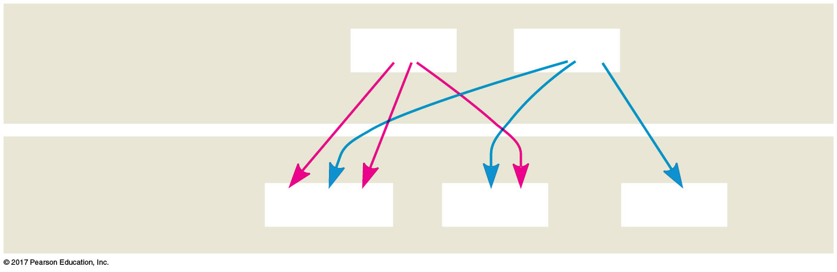
Figure 11.5
Reactants:
6 CO₂
12 H₂O
Products:
C₆H₁₂O₆
6 H₂O
6 O₂
© 2018 Pearson Education Ltd.
Notes:
Figure 11.5 Tracking atoms through photosynthesis

Slide 14
Photosynthesis as a Redox Process
Photosynthesis reverses the direction of electron flow compared to respiration
Photosynthesis is a redox process in which H₂O is oxidized and CO₂ is reduced
Photosynthesis is an endergonic process; the energy boost is provided by light

Slide 15
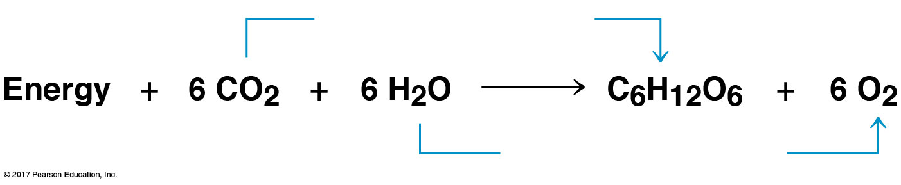
Figure 11.UN01
becomes reduced
becomes oxidized
© 2018 Pearson Education Ltd.
Notes:
Figure 11.UN01 In-text figure, photosynthesis equation, p. 263

Slide 16
The Two Stages of Photosynthesis: A Preview
Photosynthesis consists of the light reactions (the photo part) and Calvin cycle (the synthesis part)
The light reactions (in the thylakoids)
Split H₂O
Release O₂
Reduce the electron acceptor NADP⁺ to NADPH
Generate ATP from ADP by photophosphorylation

Slide 17
The Calvin cycle (in the stroma) forms sugar from CO₂, using ATP and NADPH
The Calvin cycle begins with carbon fixation, incorporating CO₂ into organic molecules

Slide 18
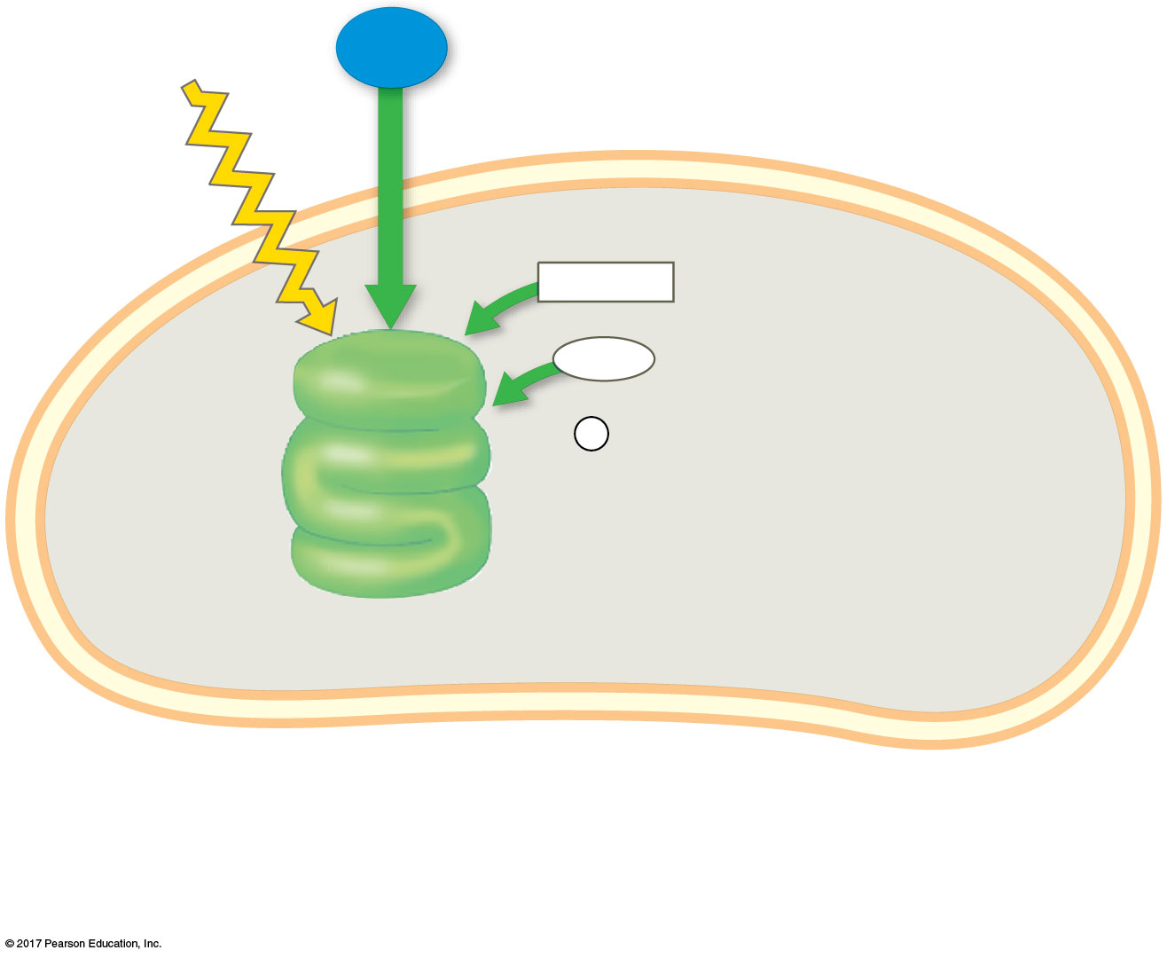
Figure 11.6_1
Light
H₂O
NADP⁺
ADP
+
LIGHT
REACTIONS
P
i
Thylakoid
Stroma
Chloroplast
© 2018 Pearson Education Ltd.
Notes:
Figure 11.6_1 An overview of photosynthesis: cooperation of the light reactions and the Calvin cycle (step 1)

Slide 19
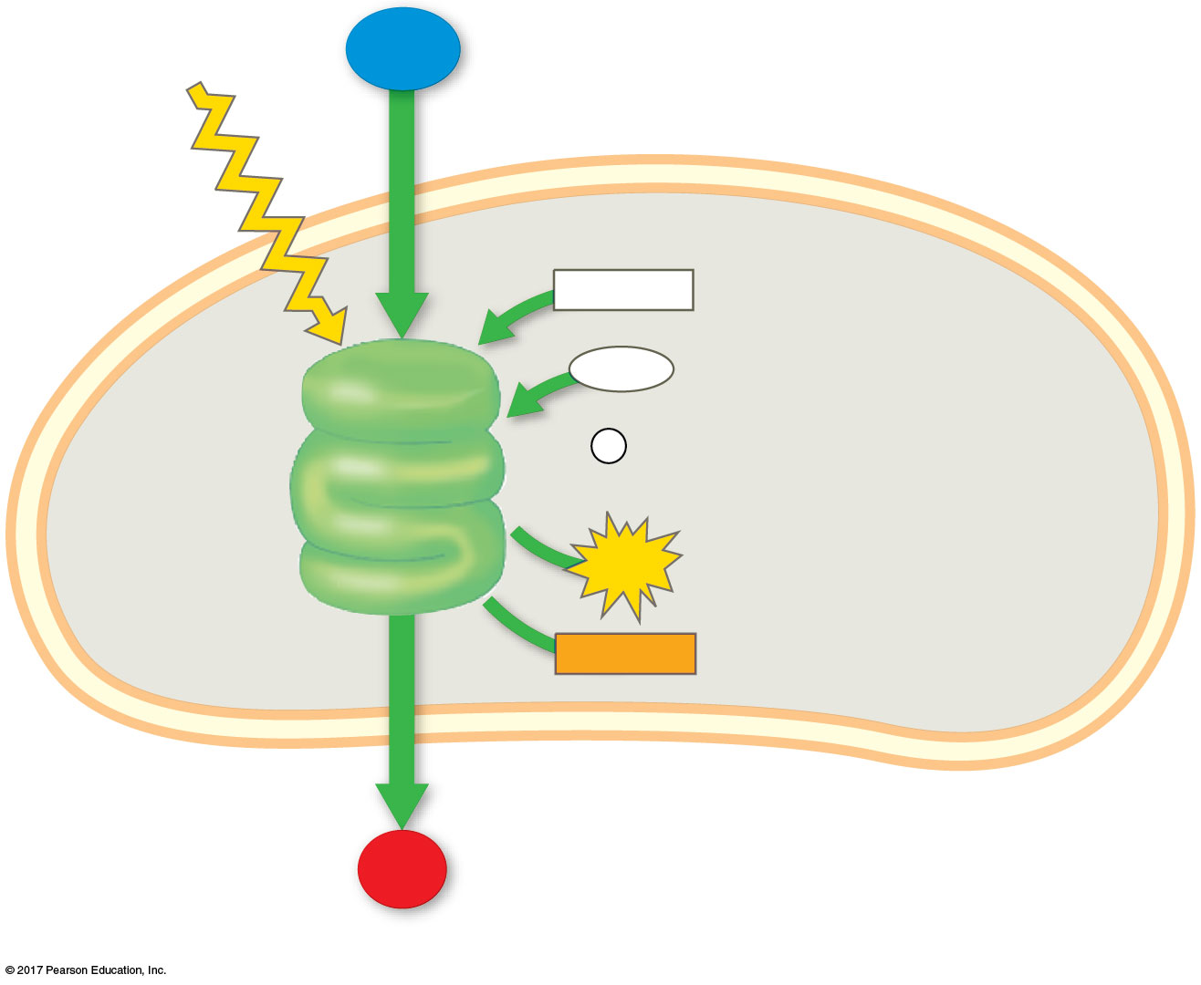
Figure 11.6_2
Light
H₂O
NADP⁺
ADP
+
LIGHT
REACTIONS
P
i
ATP
Thylakoid
Stroma
NADPH
Chloroplast
O₂
© 2018 Pearson Education Ltd.
Notes:
Figure 11.6_2 An overview of photosynthesis: cooperation of the light reactions and the Calvin cycle (step 2)

Slide 20
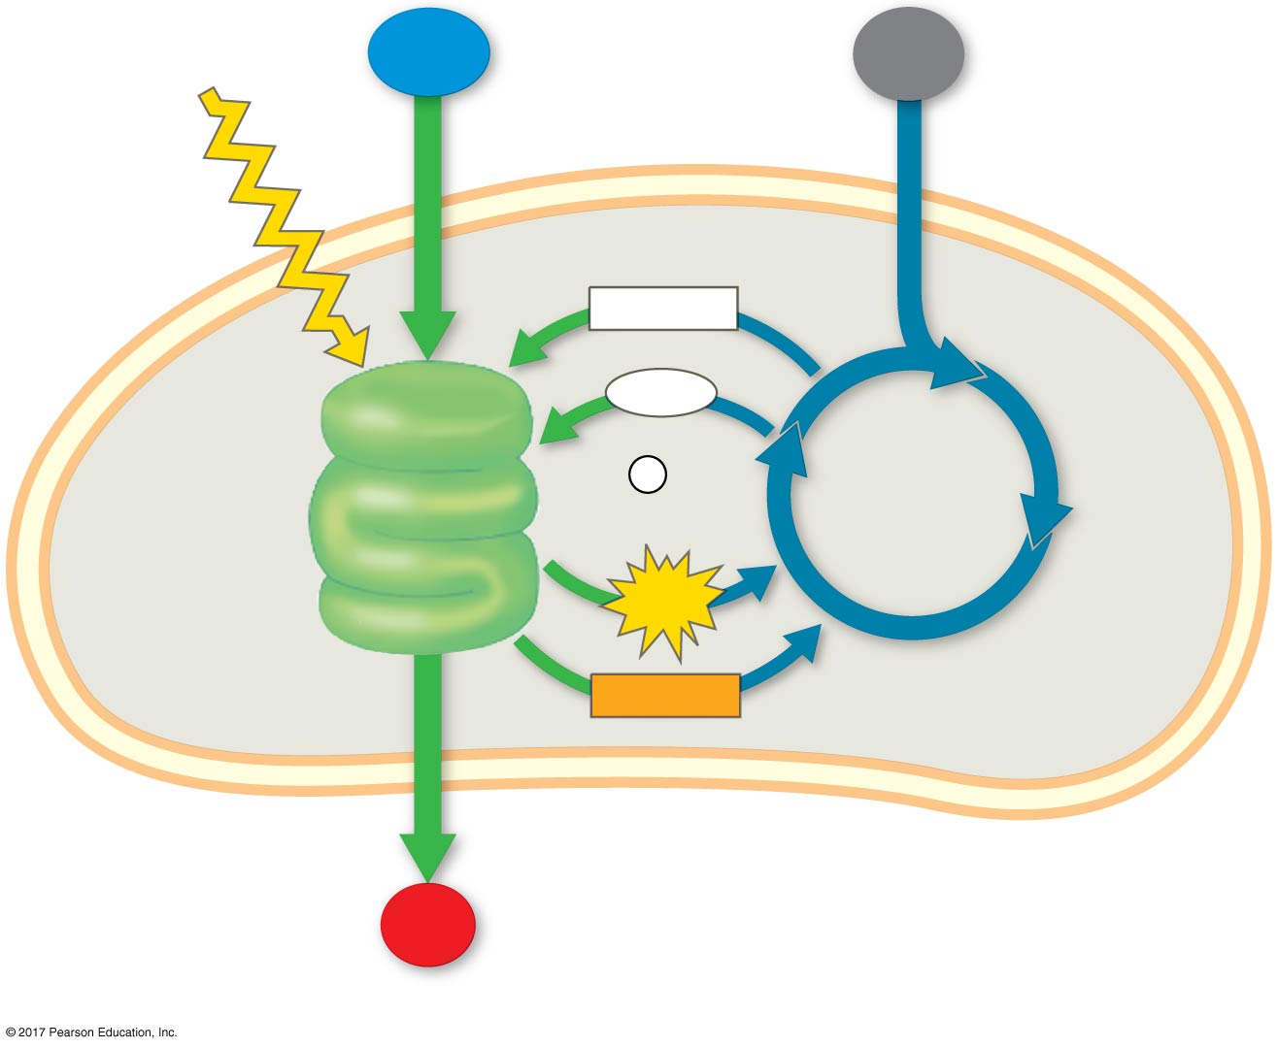
Figure 11.6_3
Light
H₂O
CO₂
NADP⁺
ADP
+
LIGHT
REACTIONS
P
i
CALVIN
CYCLE
ATP
Thylakoid
Stroma
NADPH
Chloroplast
O₂
© 2018 Pearson Education Ltd.
Notes:
Figure 11.6_3 An overview of photosynthesis: cooperation of the light reactions and the Calvin cycle (step 3)

Slide 21
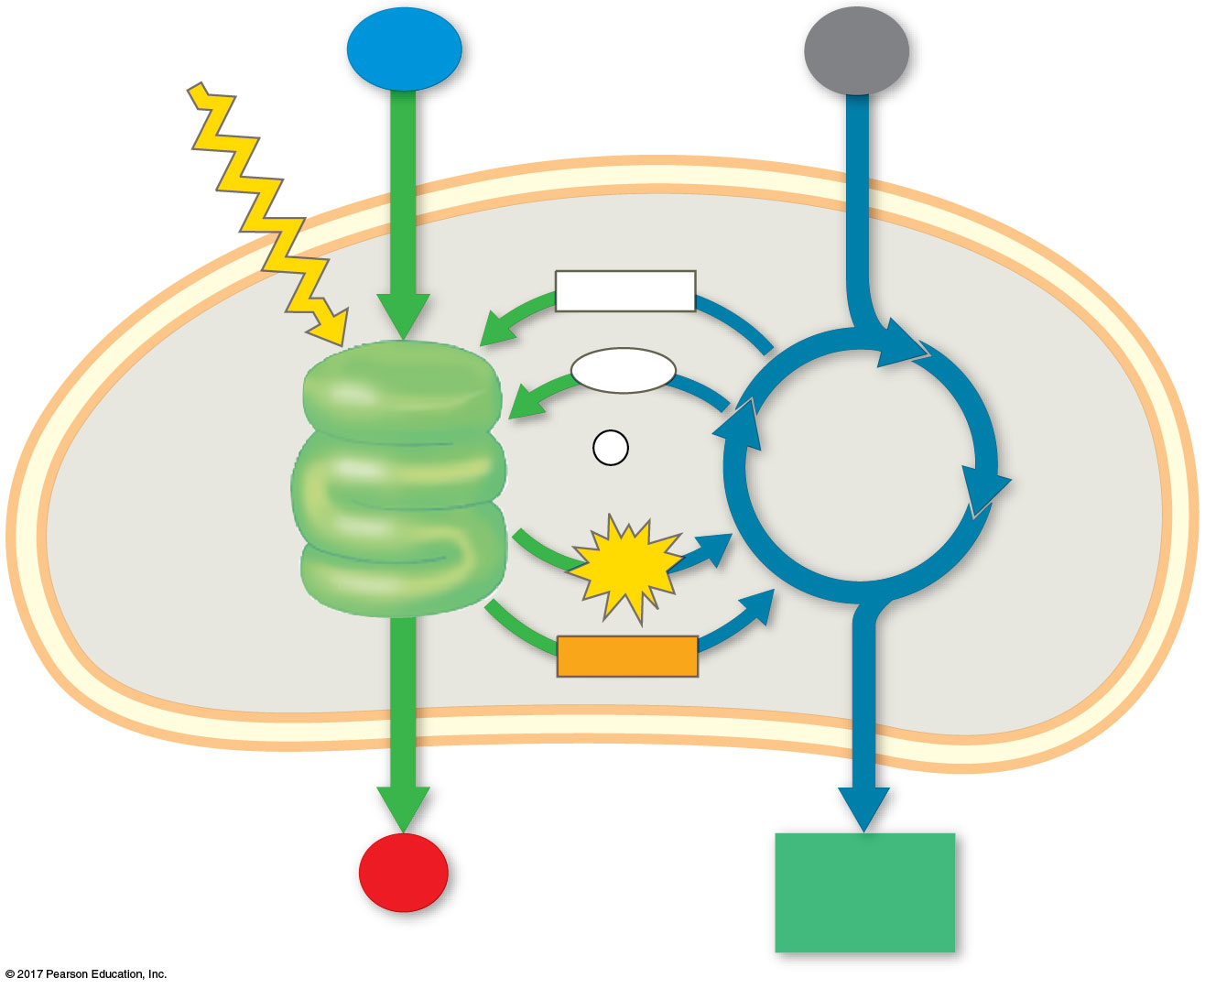
Figure 11.6_4
Light
H₂O
CO₂
NADP⁺
ADP
+
LIGHT
REACTIONS
P
i
CALVIN
CYCLE
ATP
Thylakoid
Stroma
NADPH
Chloroplast
O₂
[CH₂O]
(sugar)
© 2018 Pearson Education Ltd.
Notes:
Figure 11.6_4 An overview of photosynthesis: cooperation of the light reactions and the Calvin cycle (step 4)

Slide 22
Concept 11.2: The light reactions convert solar energy to the chemical energy of ATP and NADPH
Chloroplasts are solar-powered chemical factories
Their thylakoids transform light energy into the chemical energy of ATP and NADPH

Slide 23
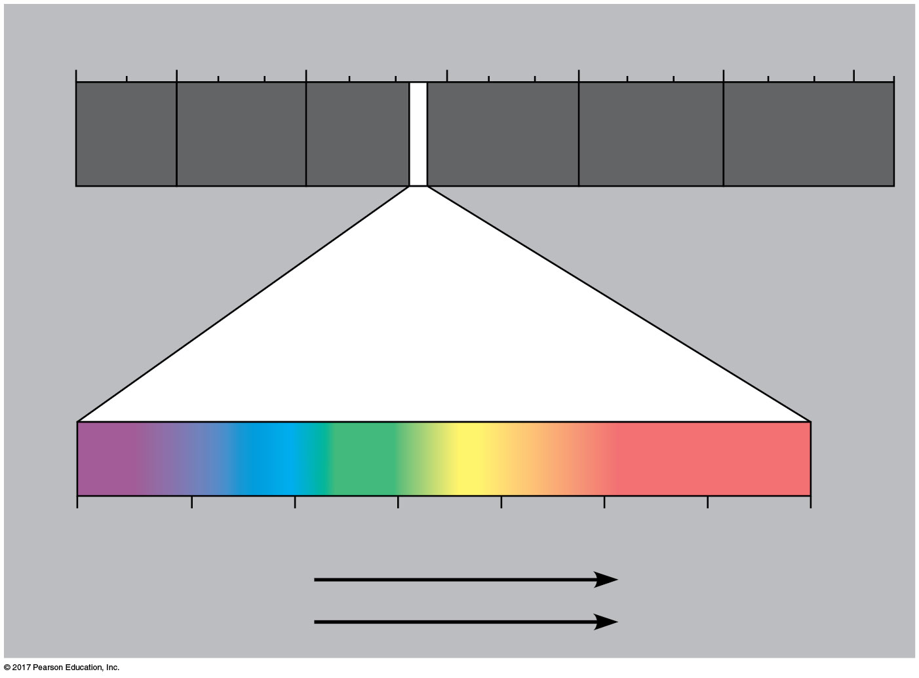
Figure 11.7
1 m
10^{–5} nm
10^{–3} nm
1 nm
10³ nm
10⁶ nm
(10⁹ nm)
10³ m
Gamma
rays
Micro-
waves
Radio
waves
X-rays
UV
Infrared
Visible light
380
450
500
550
600
650
700
750 nm
Shorter wavelength
Longer wavelength
Higher energy
Lower energy
© 2018 Pearson Education Ltd.
Notes:
Figure 11.7 The electromagnetic spectrum

Slide 24
Photosynthetic Pigments: The Light Receptors
Pigments are substances that absorb visible light
Different pigments absorb different wavelengths
Wavelengths that are not absorbed are reflected or transmitted
Leaves appear green because chlorophyll reflects and transmits green light

Slide 25
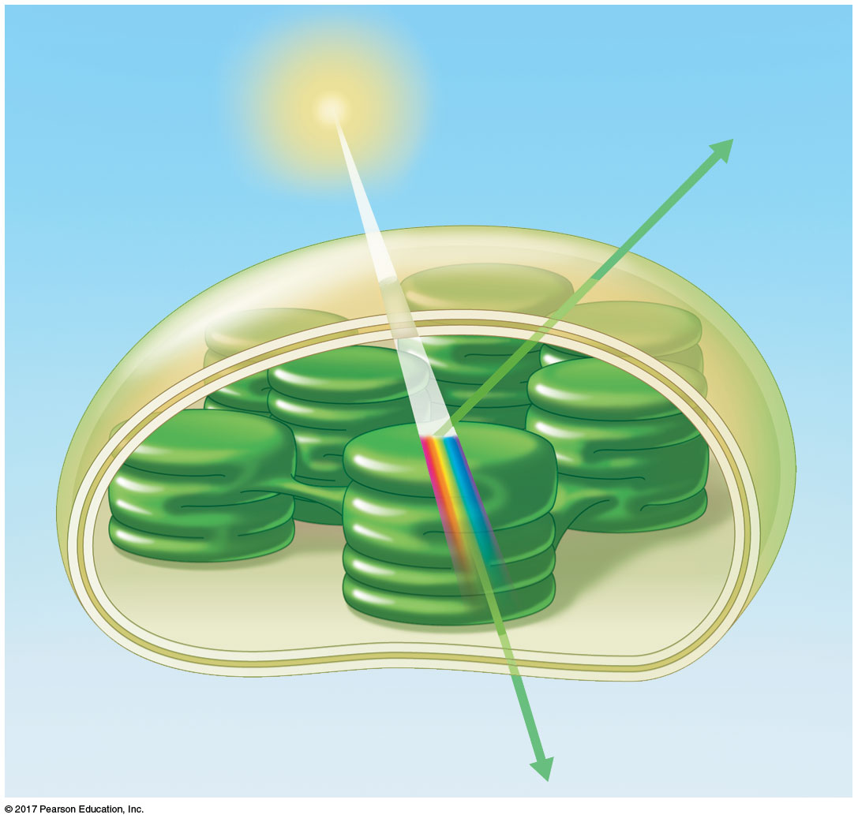
Figure 11.8
Light
Reflected
light
Chloroplast
Absorbed
light
Granum
Transmitted
light
© 2018 Pearson Education Ltd.
Notes:
Figure 11.8 Why leaves are green: interaction of light with chloroplasts

Slide 26
There are three types of pigments in chloroplasts:
Chlorophyll a, the key light-capturing pigment
Chlorophyll b, an accessory pigment
Carotenoids, a separate group of accessory pigments

Slide 27
Accessory pigments called carotenoids may broaden the spectrum of colors that drive photosynthesis
Some carotenoids function in photoprotection; they absorb excessive light that would damage chlorophyll or react with oxygen

Slide 28
Excitation of Chlorophyll by Light
When a pigment absorbs light, it goes from a ground state to an excited state, which is unstable
When excited electrons fall back to the ground state, excess energy is released as heat
In isolation, some pigments also emit light, an afterglow called fluorescence

Slide 29
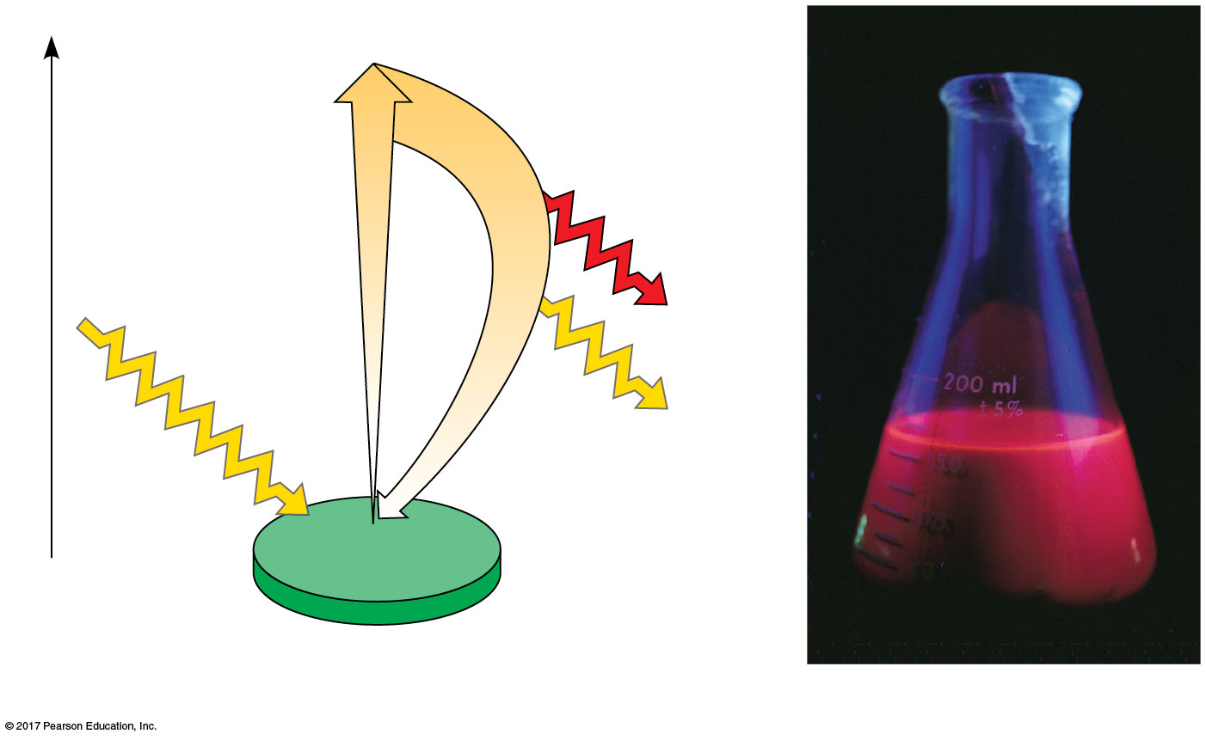
Figure 11.12
Excited
state
e–
Energy of electron
Heat
Photon
(fluorescence)
Photon
Ground
state
Chlorophyll
molecule
(a) Excitation of isolated chlorophyll molecule
(b) Fluorescence
© 2018 Pearson Education Ltd.
Notes:
Figure 11.12 Excitation of isolated chlorophyll by light

Slide 30
A Photosystem: A Reaction-Center Complex Associated with Light-Harvesting Complexes
A photosystem consists of a reaction-center complex surrounded by light-harvesting complexes
The reaction-center complex is an association of proteins holding a special pair of chlorophyll a molecules and a primary electron acceptor

Slide 31
The light-harvesting complex consists of pigment molecules bound to proteins
Light-harvesting complexes transfer the energy of photons to the chlorophyll a molecules in the reaction-center complex
These chlorophyll a molecules are special because they can transfer an excited electron to a different molecule

Slide 32
A primary electron acceptor in the reaction center accepts excited electrons and is reduced as a result
Solar-powered transfer of an electron from a chlorophyll a molecule to the primary electron acceptor is the first step of the light reactions

Slide 33
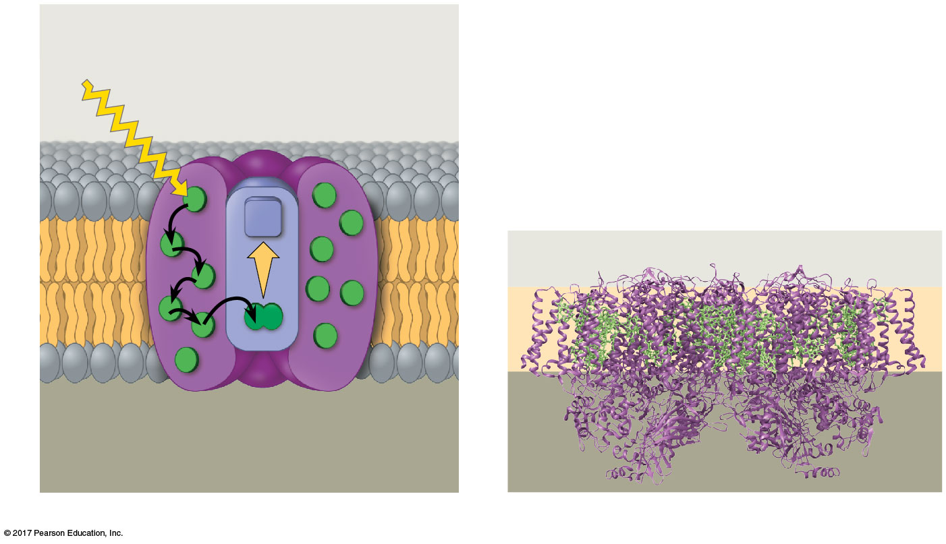
Figure 11.13
Photosystem
STROMA
Photon
Light-
harvesting
complexes
Reaction-
center
complex
Primary
electron
acceptor
Thylakoid membrane
Thylakoid membrane
Chlorophyll (green)
STROMA
e–
Transfer
of energy
Special pair of chloro-
phyll a molecules
Pigment
molecules
Protein
subunits
(purple)
THYLAKOID SPACE
(INTERIOR OF THYLAKOID)
THYLAKOID
SPACE
(a) How a photosystem harvests light
(b) Structure of a photosystem
© 2018 Pearson Education Ltd.
Notes:
Figure 11.13 The structure and function of a photosystem

Slide 34
There are two types of photosystems in the thylakoid membrane
Photosystem II (PS II) functions first (the numbers reflect order of discovery)
The reaction-center chlorophyll a of PS II is called P680 because it is best at absorbing a wavelength of 680 nm

Slide 35
Photosystem I (PS I) is best at absorbing a wavelength of 700 nm
The reaction-center chlorophyll a of PS I is called P700

Slide 36
Linear Electron Flow
During the light reactions, there are two possible routes for electron flow: cyclic and linear
Linear electron flow, the primary pathway, involves both photosystems and produces ATP and NADPH using light energy

Slide 37
There are eight steps in linear electron flow:
A photon hits a pigment in a light-harvesting complex of PS II, and its energy is passed among pigment molecules until it excites P680
An excited electron from P680 is transferred to the primary electron acceptor (we now call it P680⁺)

Slide 38
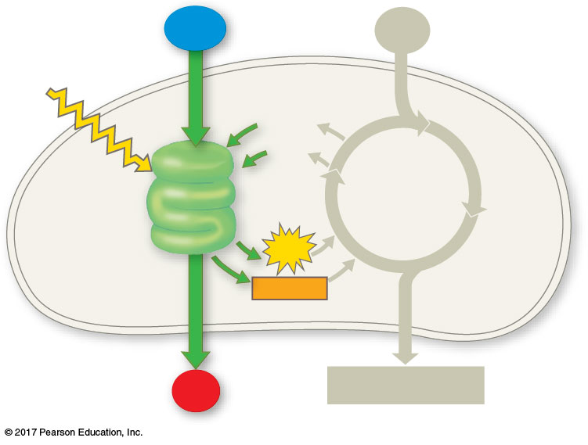
Figure 11.UN02
H₂O
CO₂
Light
NADP⁺
ADP
LIGHT
REACTIONS
CALVIN
CYCLE
ATP
NADPH
O₂
[CH₂O] (sugar)
© 2018 Pearson Education Ltd.
Notes:
Figure 11.UN02 In-text figure, light reaction schematic, p. 269

Slide 39
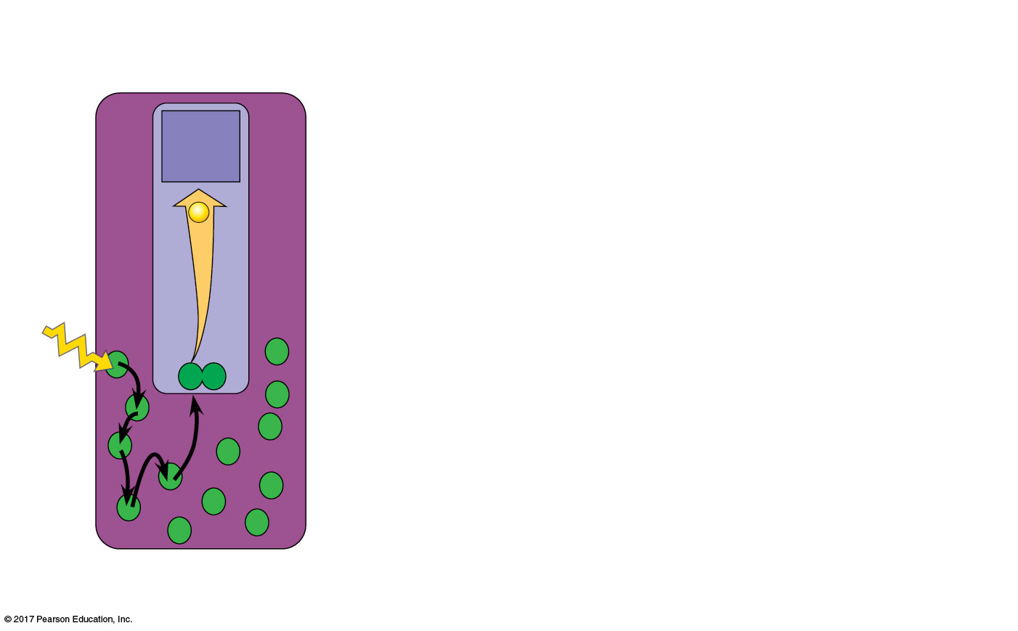
Figure 11.14_1
Primary
electron
acceptor
2
e–
1
P680
Light
Pigment
molecules
Photosystem II
(PS II)
© 2018 Pearson Education Ltd.
Notes:
Figure 11.14_1 How linear electron flow during the light reactions generates ATP and NADPH (step 1)

Slide 40
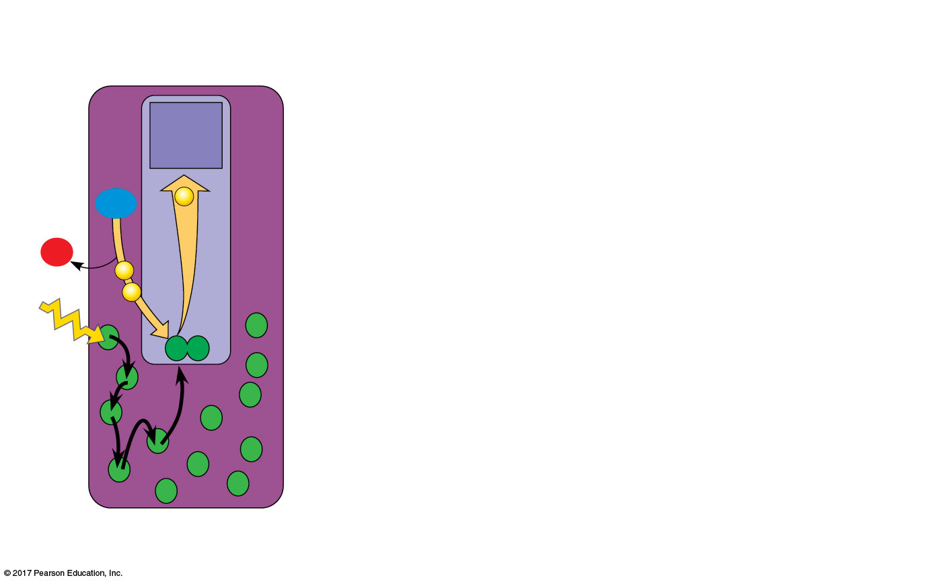
Figure 11.14_2
Primary
electron
acceptor
2 H⁺
2
H₂O
e–
+
1
/2
O₂
3
e–
1
e–
P680
Light
Pigment
molecules
Photosystem II
(PS II)
© 2018 Pearson Education Ltd.
Notes:
Figure 11.14_2 How linear electron flow during the light reactions generates ATP and NADPH (step 2)

Slide 41
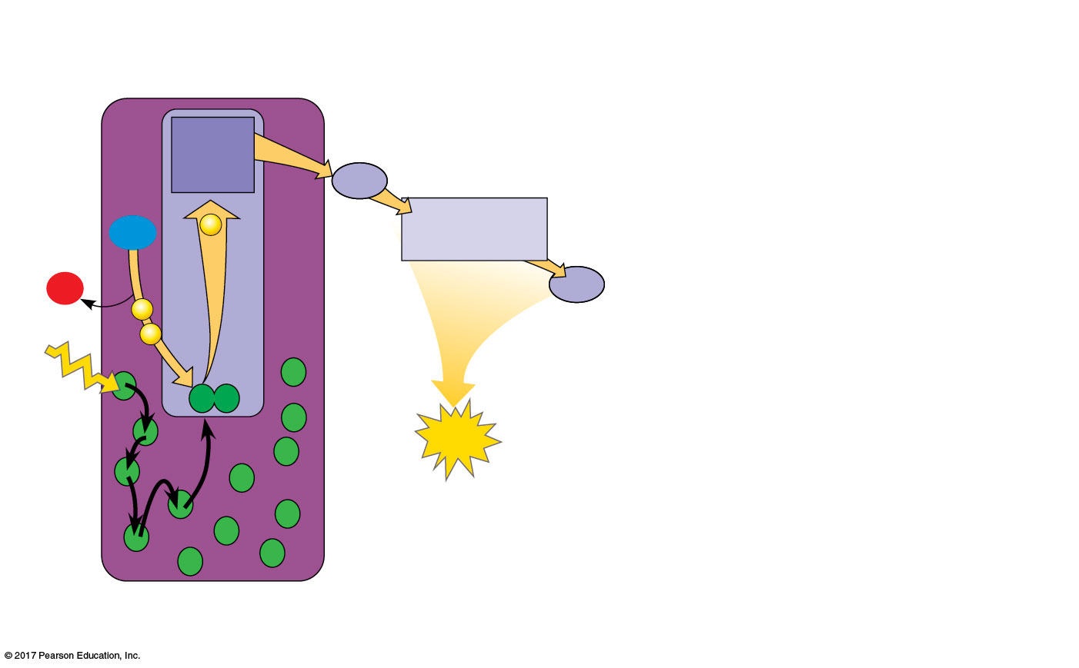
Figure 11.14_3
4
Electron
transport chain
Primary
electron
acceptor
Pq
2 H⁺
2
Cytochrome
complex
H₂O
e–
+
1
/2
O₂
3
Pc
e–
1
e–
P680
5
Light
ATP
Pigment
molecules
Photosystem II
(PS II)
© 2018 Pearson Education Ltd.
Notes:
Figure 11.14_3 How linear electron flow during the light reactions generates ATP and NADPH (step 3), plastoquinone (Pq) e carrier and plastocyanin (Pc) copper containing

Slide 42
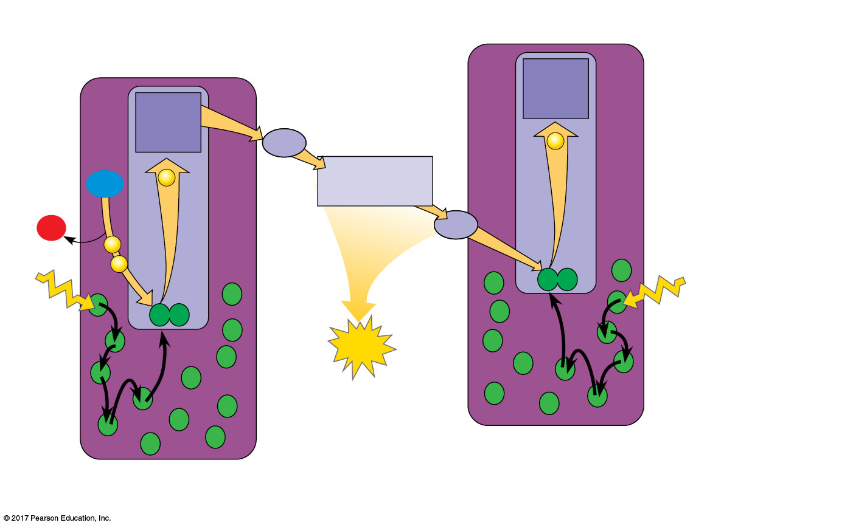
Figure 11.14_4
4
Electron
transport chain
Primary
electron
acceptor
Primary
electron
acceptor
Pq
e–
2 H⁺
2
Cytochrome
complex
H₂O
e–
+
1
/2
O₂
3
Pc
e–
P700
1
e–
P680
5
Light
Light
6
ATP
Pigment
molecules
Photosystem I
(PS I)
Photosystem II
(PS II)
© 2018 Pearson Education Ltd.
Notes:
Figure 11.14_4 How linear electron flow during the light reactions generates ATP and NADPH (step 4)

Slide 43
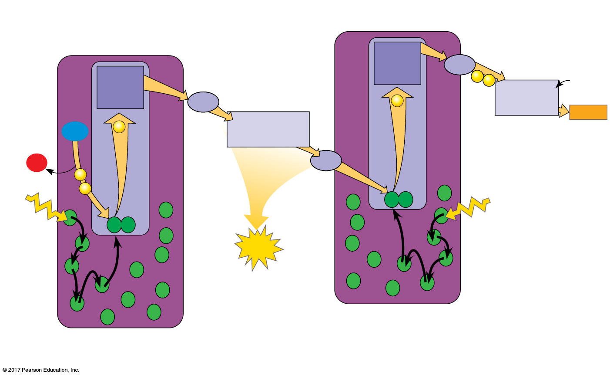
Figure 11.14_5
7
Electron
transport chain
4
Electron
transport chain
Primary
electron
acceptor
Fd
8
NADP⁺
+ H⁺
Primary
electron
acceptor
e–
e–
Pq
NADP⁺
reductase
e–
2
NADPH
2 H⁺
H₂O
e–
Cytochrome
complex
+
1
/2
O₂
3
Pc
e–
P700
1
e–
P680
5
Light
Light
6
ATP
Pigment
molecules
Photosystem I
(PS I)
Photosystem II
(PS II)
© 2018 Pearson Education Ltd.
Notes:
Figure 11.14_5 How linear electron flow during the light reactions generates ATP and NADPH (step 5), ferrodoxin iron containing protein

Slide 44
H₂O is split by enzymes, and the electrons are transferred from the hydrogen atoms to P680⁺, thus reducing it to P680
P680⁺ is the strongest known biological oxidizing agent
The H⁺ are released into the thylakoid space
O₂ is released as a by-product of this reaction
https://www.youtube.com/watch?v=qJqEk1ouDuo

Slide 45
Each electron “falls” down an electron transport chain from the primary electron acceptor of PS II to PS I. Energy released by the fall drives the creation of a proton gradient across the thylakoid membrane
Potential energy stored in the proton gradient drives production of ATP by chemiosmosis

Slide 46
In PS I (like PS II), transferred light energy excites P700, which loses an electron to the primary electron acceptor
P700⁺ (P700 that is missing an electron) accepts an electron passed down from PS II via the electron transport chain

Slide 47
Each electron “falls” down an electron transport chain from the primary electron acceptor of PS I to the protein ferredoxin (Fd)
NADP⁺ reductase catalyzes the transfer of electrons to NADP⁺, reducing it to NADPH
The electrons of NADPH are available for the reactions of the Calvin cycle
This process also removes an H⁺ from the stroma

Slide 48
The energy changes of electrons during linear flow through the light reactions can be shown in a mechanical analogy

Slide 49
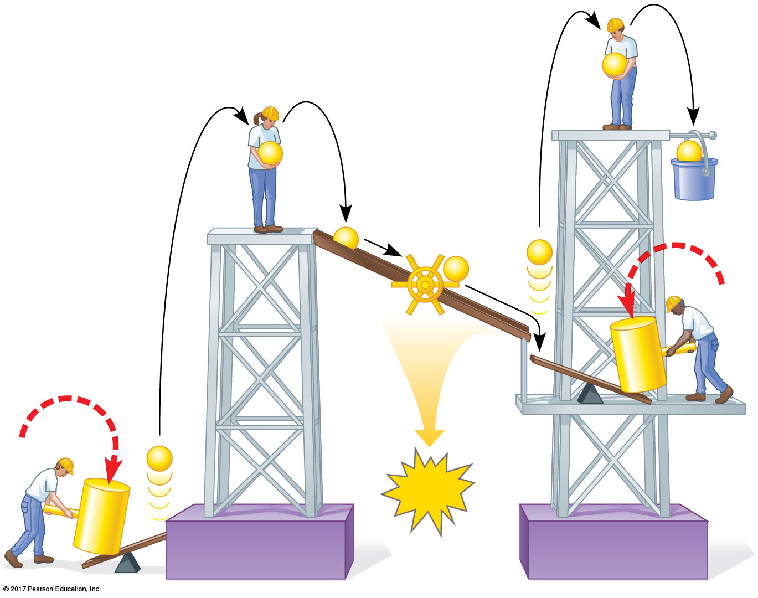
Figure 11.15
e–
e–
e–
Mill
makes
NADPH
e–
ATP
e–
e–
Photon
e–
ATP
Photon
Photosystem II
Photosystem I
© 2018 Pearson Education Ltd.
Notes:
Figure 11.15 A mechanical analogy for linear electron flow during the light reactions

Slide 50
Cyclic Electron Flow
In cyclic electron flow, electrons cycle back from Fd to the PS I reaction center via a plastocyanin molecule (Pc)
Cyclic electron flow uses only photosystem I and produces ATP, but not NADPH
No oxygen is released

Slide 51
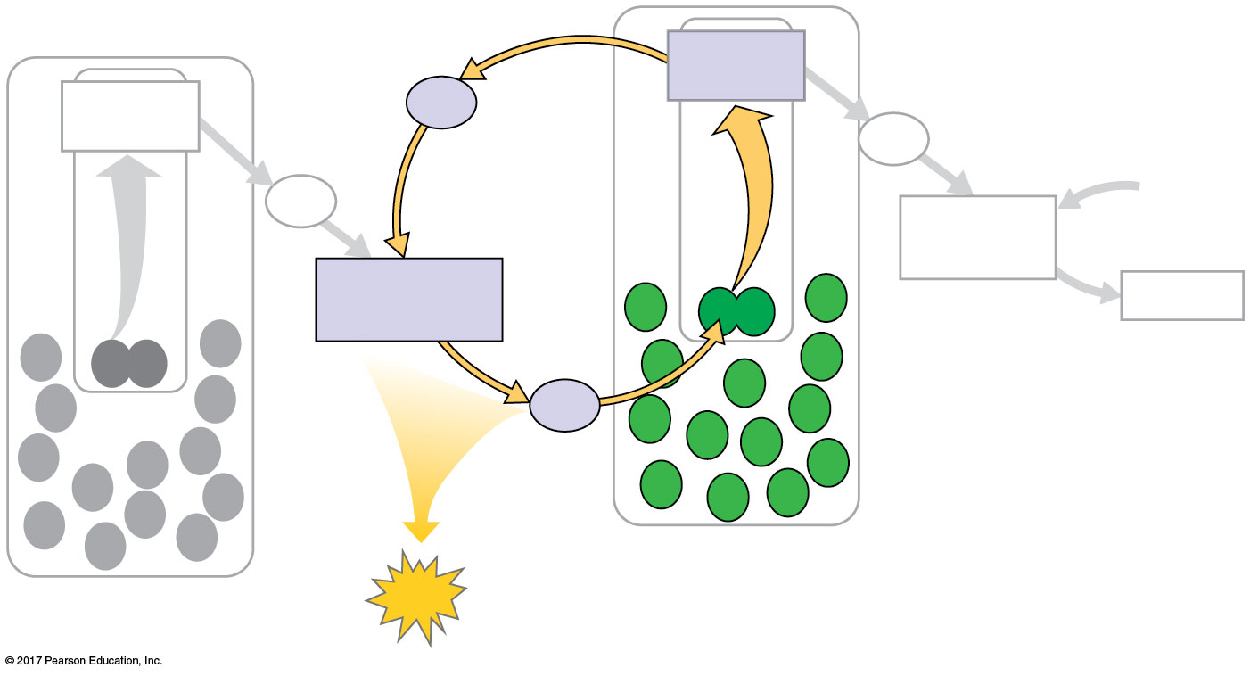
Figure 11.16
Primary
acceptor
Primary
acceptor
Fd
Fd
Pq
NADP⁺
NADP⁺
reductase
+ H⁺
Cytochrome
complex
NADPH
Pc
Photosystem I
Photosystem II
ATP
© 2018 Pearson Education Ltd.
Notes:
Figure 11.16 Cyclic electron flow

Slide 52
Some organisms such as purple sulfur bacteria have PS I but not PS II (2CO2 + H2S + H2O------2(CH2O) + H2SO4.
Cyclic electron flow is thought to have evolved before linear electron flow
Cyclic electron flow may protect cells from light-induced damage

Slide 53
ATP and NADPH are produced on the side facing the stroma, where the Calvin cycle takes place
In summary, light reactions generate ATP and increase the potential energy of electrons by moving them from H₂O to NADPH

Slide 54
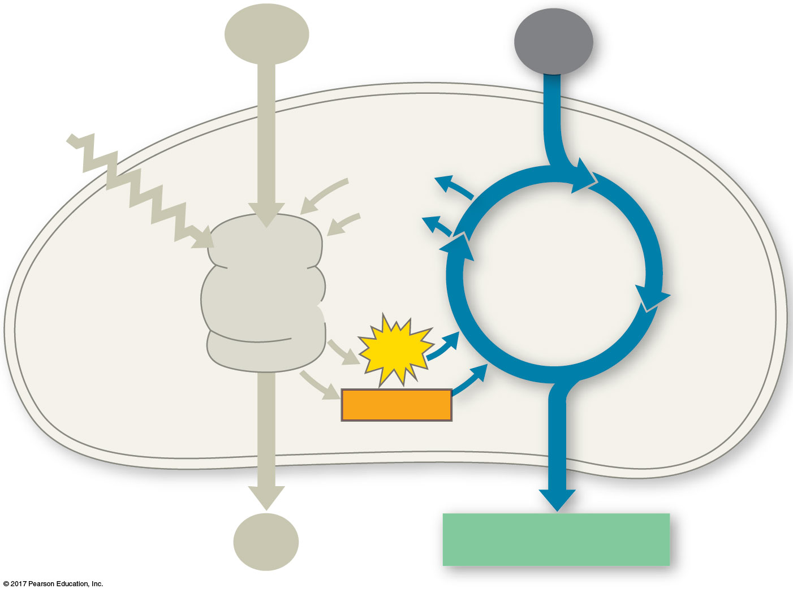
Figure 11.UN03
H₂O
CO₂
Light
NADP⁺
ADP
CALVIN
CYCLE
LIGHT
REACTIONS
ATP
NADPH
O₂
[CH₂O] (sugar)
© 2018 Pearson Education Ltd.
Notes:
Figure 11.UN03 In-text figure, Calvin cycle schematic, p. 274

Slide 55
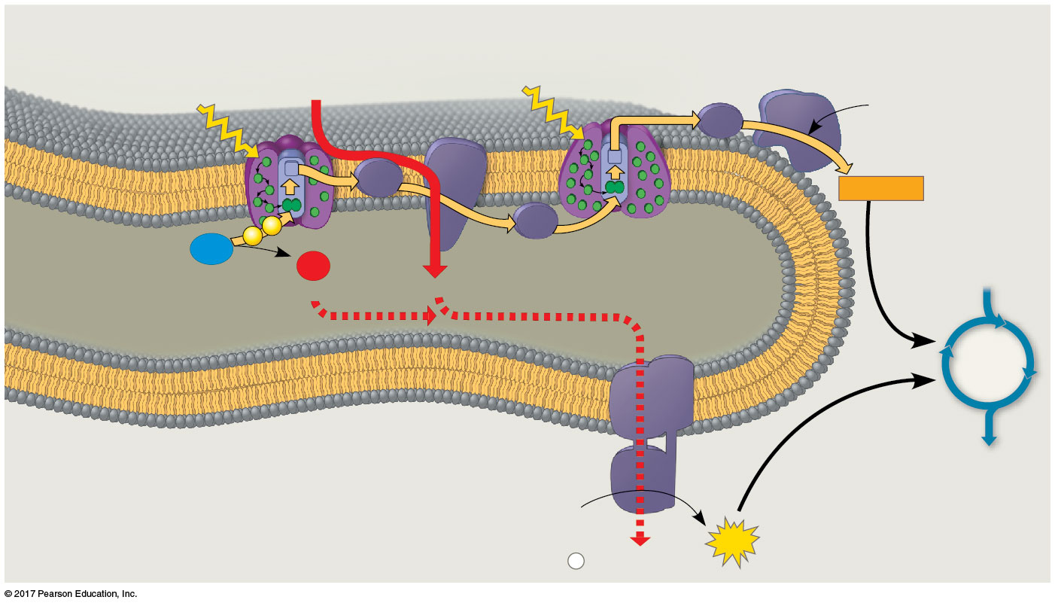
Figure 11.18
Cytochrome
complex
NADP⁺
reductase
Photosystem II
Photosystem I
Light
4 H⁺
Light
3
NADP⁺ + H⁺
Fd
Pq
NADPH
e–
2
Pc
H₂O
e–
1
1
/
2
O₂
THYLAKOID SPACE
(high H⁺ concentration)
+2 H⁺
4 H⁺
CALVIN
CYCLE
Thylakoid
membrane
ATP
synthase
STROMA
(low H⁺ concentration)
ADP
+
ATP
P
i
H⁺
© 2018 Pearson Education Ltd.
Notes:
Figure 11.18 The light reactions and chemiosmosis: Current model of the organization of the thylakoid membrane

Slide 56
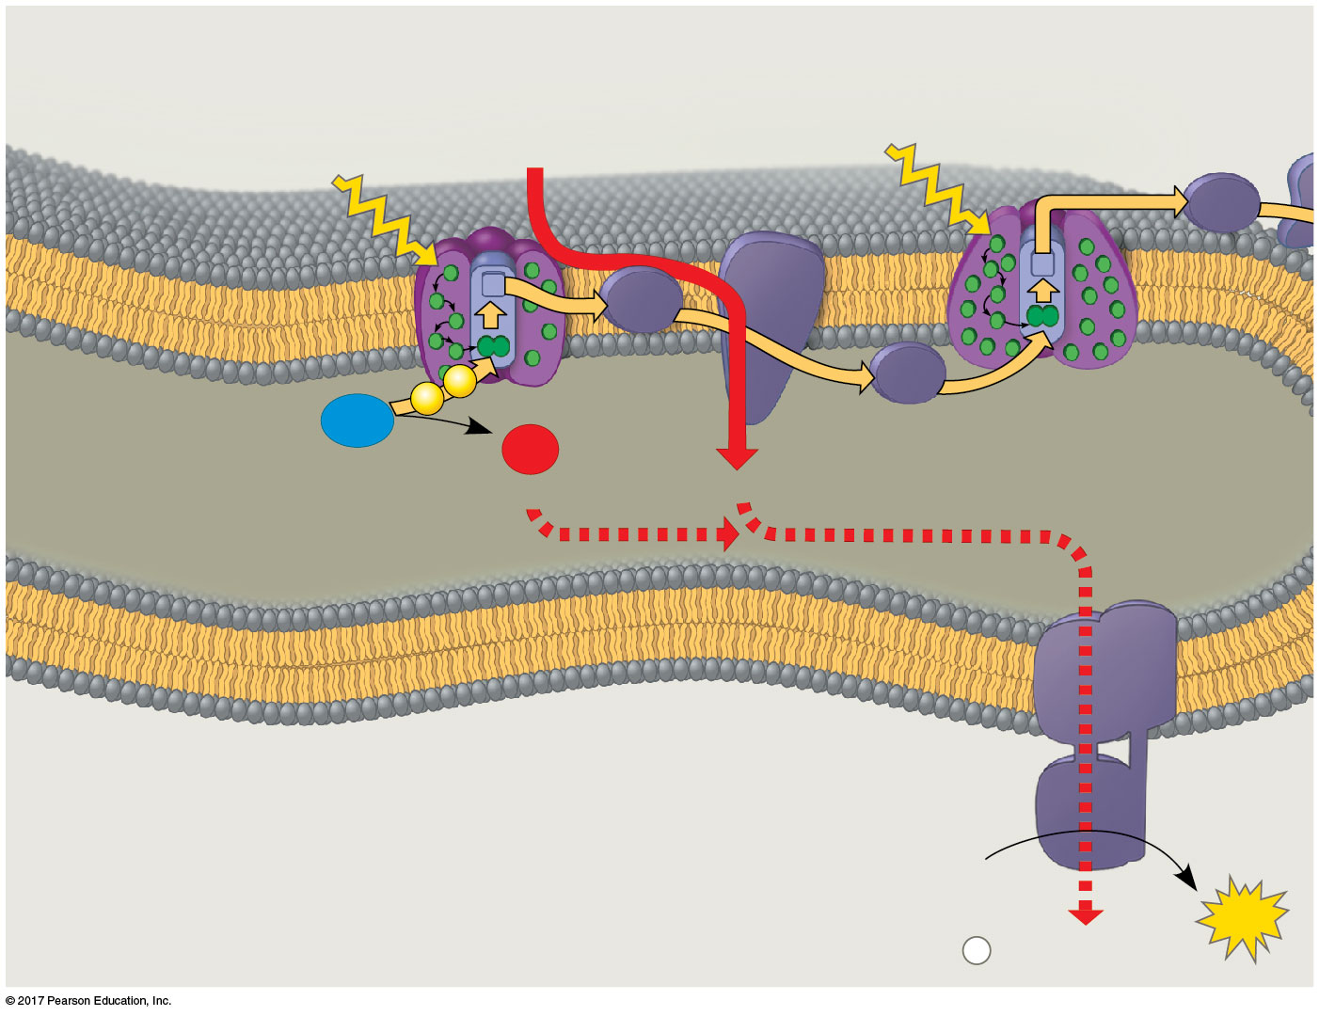
Figure 11.18a
Cytochrome
complex
Photosystem II
Photosystem I
4 H⁺
Light
Light
Fd
Pq
e–
2
Pc
H₂O
e–
1
1
O₂
THYLAKOID SPACE
(high H⁺ concentration)
/2
4 H⁺
+2 H⁺
Thylakoid
membrane
ATP
synthase
STROMA
(low H⁺ concentration)
ADP
+
ATP
P
i
H⁺
© 2018 Pearson Education Ltd.
Notes:
Figure 11.18a The light reactions and chemiosmosis: Current model of the organization of the thylakoid membrane (part 1)

Slide 57
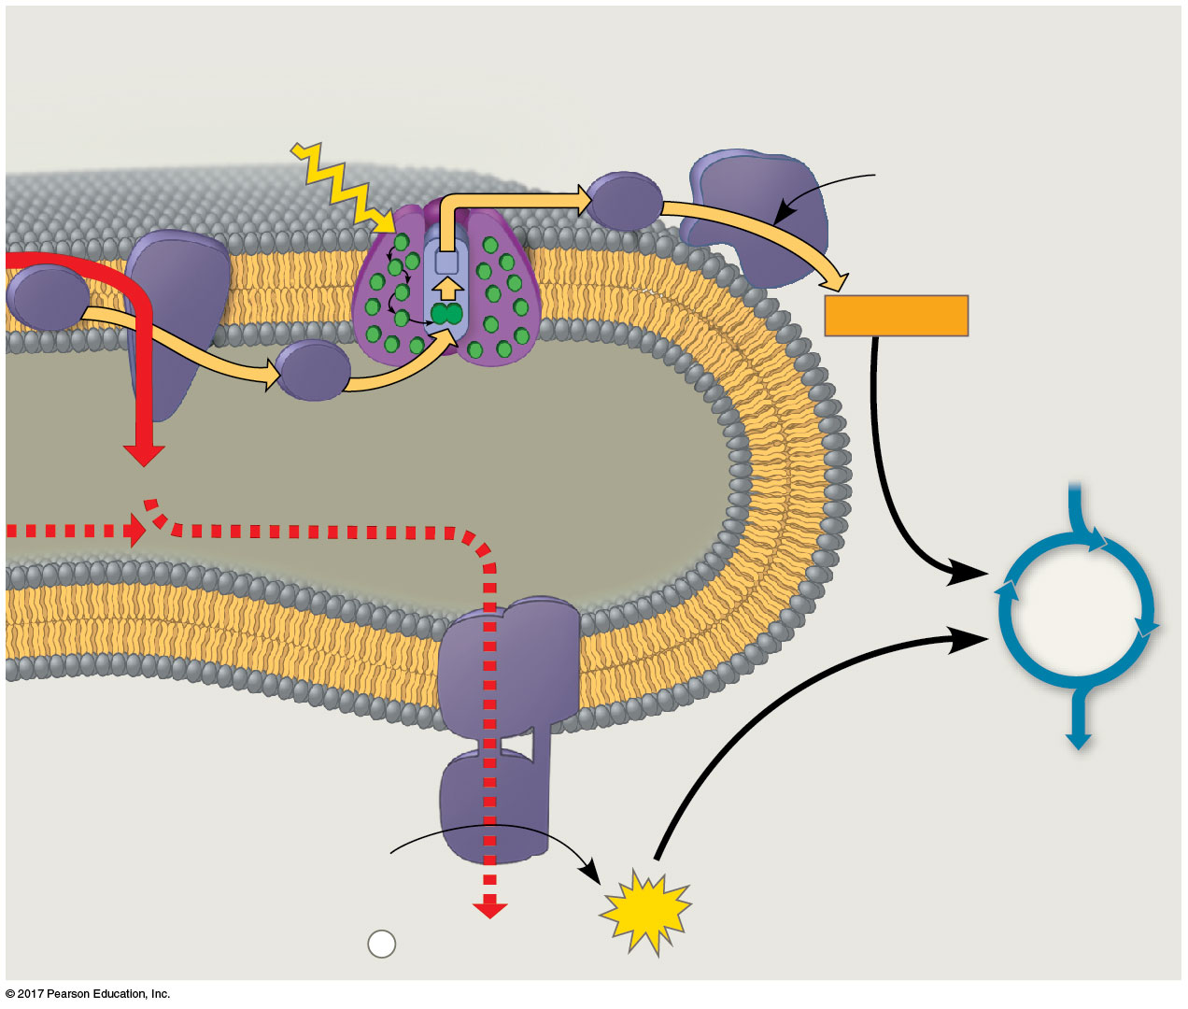
Figure 11.18b
Cytochrome
complex
NADP⁺
reductase
Photosystem I
Light
3
NADP⁺
+ H⁺
Fd
Pq
NADPH
2
Pc
THYLAKOID SPACE
(high H⁺ concentration)
4 H⁺
CALVIN
CYCLE
ATP
synthase
ADP
STROMA
(low H⁺ concentration)
+
ATP
P
i
H⁺
© 2018 Pearson Education Ltd.
Notes:
Figure 11.18b The light reactions and chemiosmosis: Current model of the organization of the thylakoid membrane (part 2)

Slide 58
Concept 11.3: The Calvin cycle uses the chemical energy of ATP and NADPH to reduce CO₂ to sugar
The Calvin cycle, like the citric acid cycle, regenerates its starting material after molecules enter and leave the cycle
The Calvin cycle is anabolic; it builds sugar from smaller molecules by using ATP and the reducing power of electrons carried by NADPH

Slide 59
Carbon enters the cycle as CO₂ and leaves as a sugar named glyceraldehyde 3-phospate (G3P)
For net synthesis of one G3P, the cycle must take place three times, fixing three molecules of CO₂
The Calvin cycle has three phases:
Carbon fixation (catalyzed by rubisco)
Reduction
Regeneration of the CO₂ acceptor (RuBP)

Slide 60
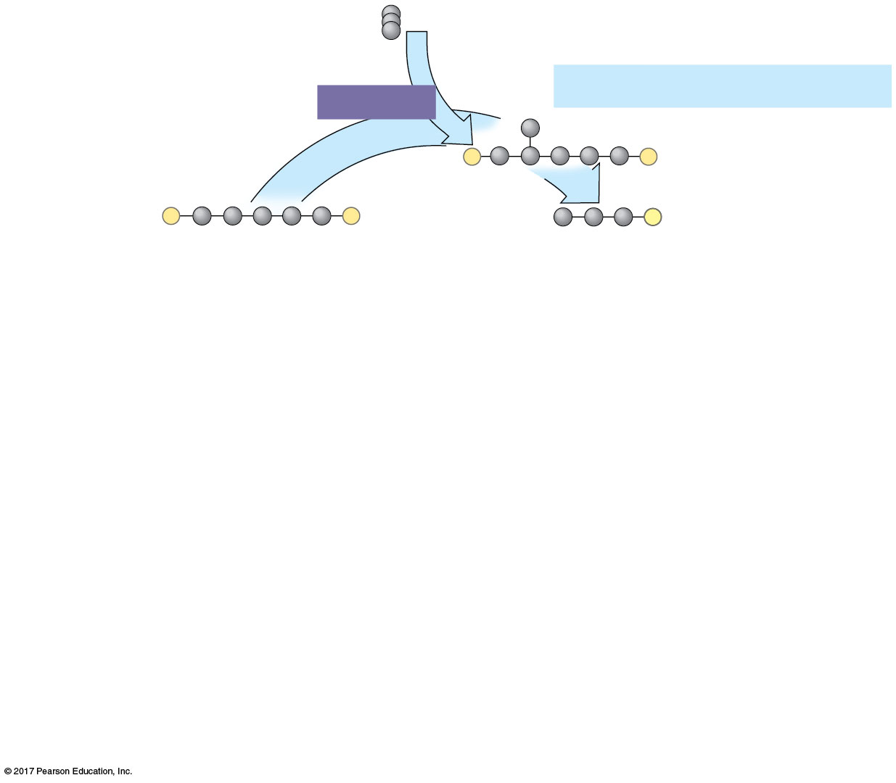
Figure 11.19_1
Input 3 CO₂, entering one per cycle
Phase 1: Carbon fixation
Rubisco
3
P
P
3
P
P
6
P
RuBP
3-Phosphoglycerate
Calvin
Cycle
© 2018 Pearson Education Ltd.
Notes:
Figure 11.19_1 The Calvin cycle (step 1)

Slide 61
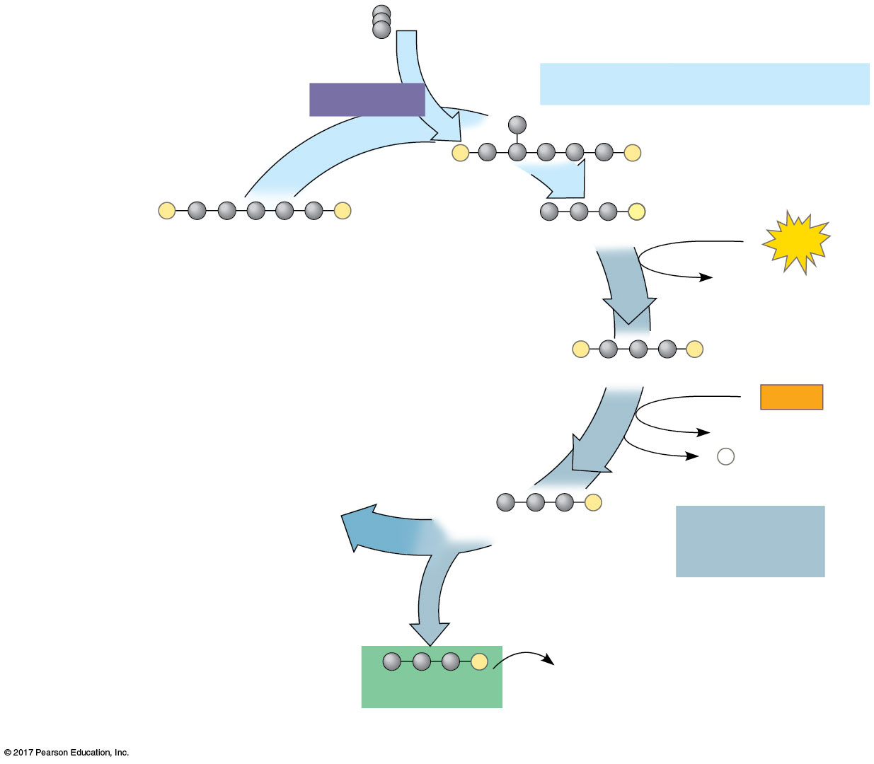
Figure 11.19_2
Input 3 CO₂, entering one per cycle
Phase 1: Carbon fixation
Rubisco
3
P
P
3
P
P
6
P
RuBP
3-Phosphoglycerate
6
ATP
6 ADP
Calvin
Cycle
6
P
P
1,3-Bisphosphoglycerate
6
NADPH
6 NADP⁺
6
P
i
6
P
G3P
Phase 2:
Reduction
1
P
Glucose and
other organic
compounds
G3P
Output
© 2018 Pearson Education Ltd.
Notes:
Figure 11.19_2 The Calvin cycle (step 2)

Slide 62
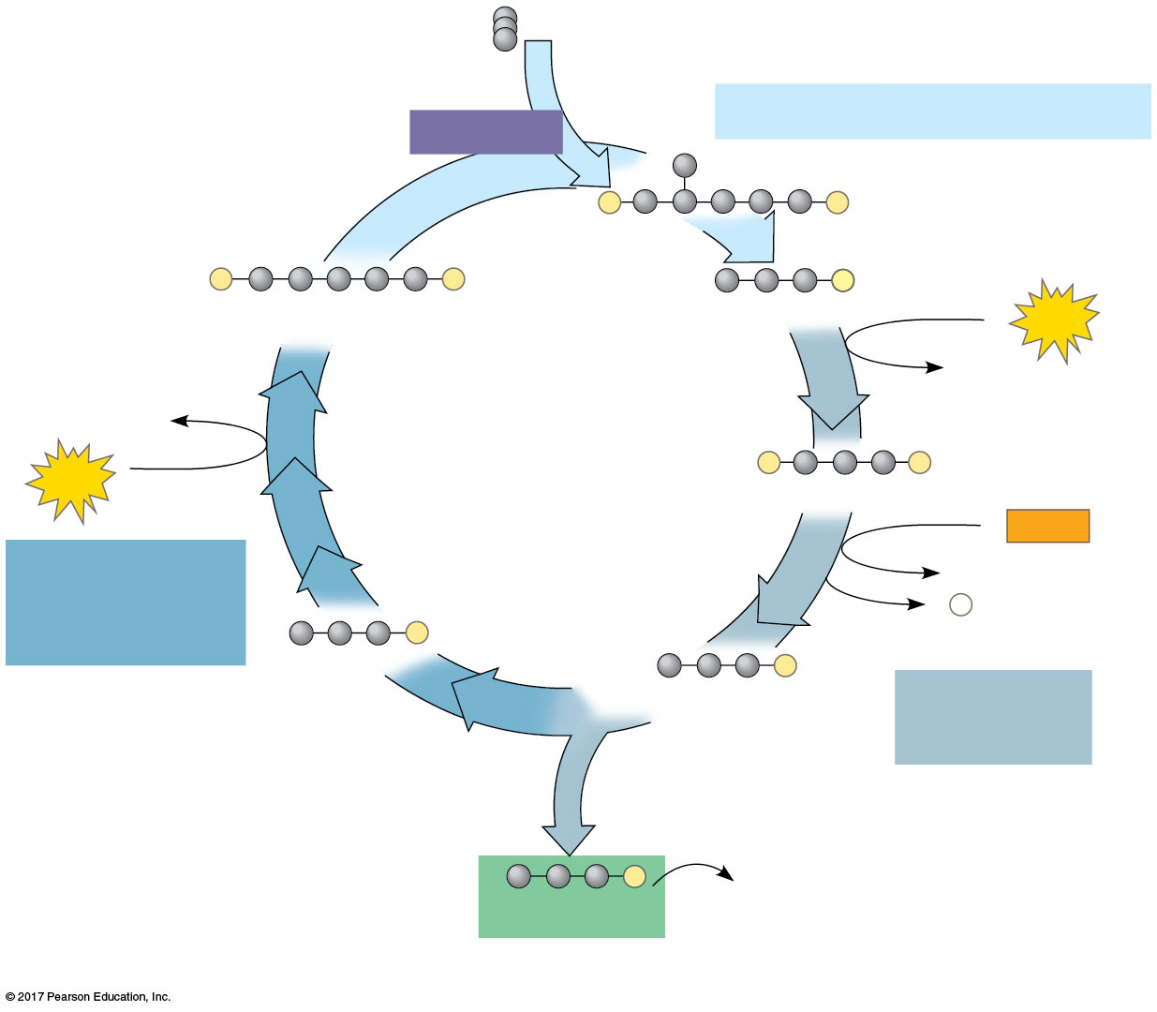
Figure 11.19_3
Input 3 CO₂, entering one per cycle
Phase 1: Carbon fixation
Rubisco
3
P
P
3
P
P
6
P
RuBP
3-Phosphoglycerate
6
ATP
6 ADP
3 ADP
Calvin
Cycle
3
ATP
6
P
P
1,3-Bisphosphoglycerate
6
NADPH
Phase 3:
Regeneration
of RuBP
6 NADP⁺
6
P
i
5
P
G3P
6
P
G3P
Phase 2:
Reduction
1
P
Glucose and
other organic
compounds
G3P
Output
© 2018 Pearson Education Ltd.
Notes:
Figure 11.19_3 The Calvin cycle (step 3)

Slide 63
Concept 11.5: Life depends on photosynthesis The Importance of Photosynthesis: A Review
The energy entering chloroplasts as sunlight gets stored as chemical energy in organic compounds
Sugar made in the chloroplasts supplies chemical energy and carbon skeletons to synthesize the organic molecules of cells
Plants store excess sugar as starch in chloroplasts and other structures such as roots, tubers, seeds, and fruits

Slide 64
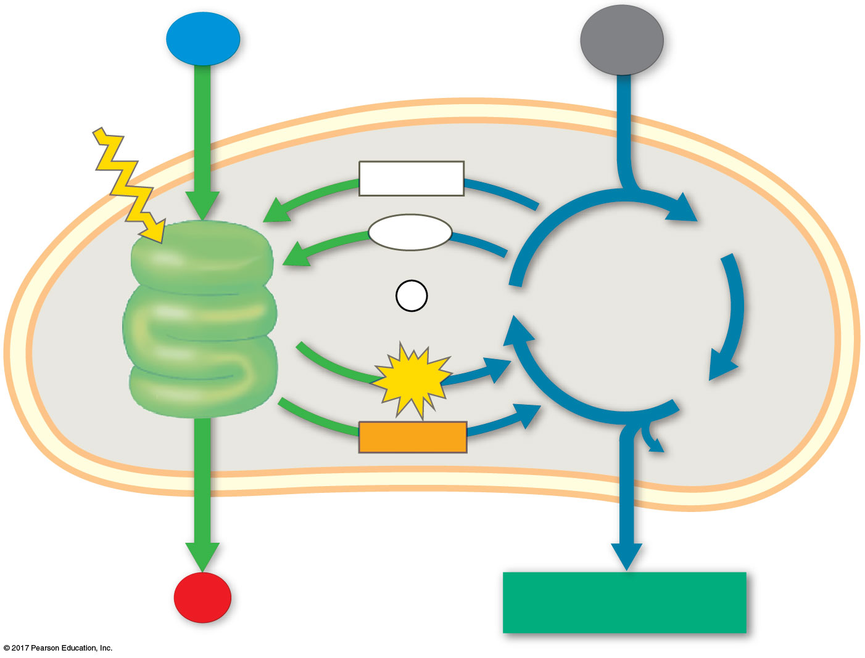
Figure 11.22b
Chloroplast
H₂O
CO₂
Light
NADP⁺
ADP
3-Phosphoglycerate
LIGHT
+
REACTIONS:
Photosystem II
P
RuBP
CALVIN
CYCLE
i
Electron transport chain
Photosystem I
Electron transport chain
ATP
G3P
NADPH
Starch
(storage)
O₂
Sucrose (export)
© 2018 Pearson Education Ltd.
Notes:
Figure 11.22b A review of photosynthesis (part 2)

Slide 65
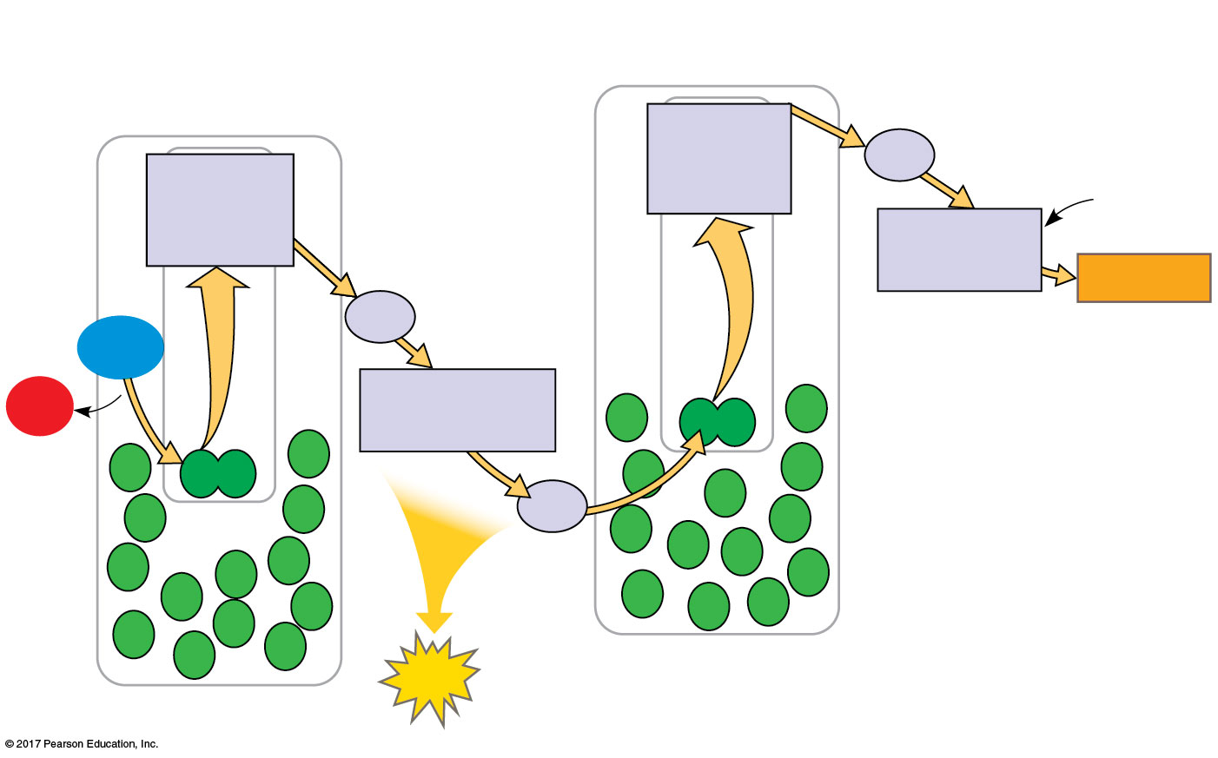
Figure 11.UN05
Electron transport
chain
Primary
electron
acceptor
Fd
Primary
electron
acceptor
NADP⁺
Electron transport
chain
NADP⁺
reductase
+ H⁺
NADPH
Pq
H₂O
O₂
Cytochrome
complex
Pc
ATP
Photosystem I
Photosystem II
© 2018 Pearson Education Ltd.
Notes:
Figure 11.UN05 Summary of key concepts: linear electron flow

Slide 66
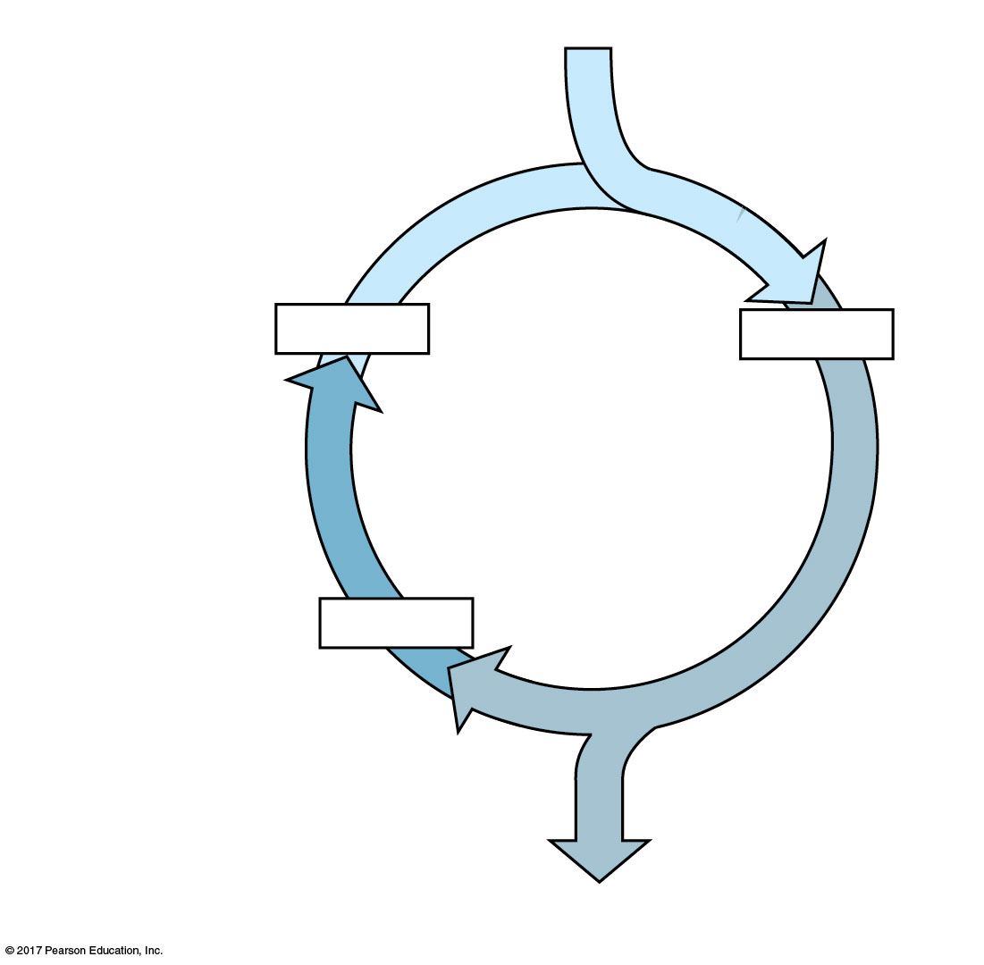
Figure 11.UN06
3 CO₂
Carbon fixation
3 x 5C
6 x 3C
Calvin
Cycle
Regeneration of
CO₂ acceptor
5 x 3C
Reduction
1 G3P (3C)
© 2018 Pearson Education Ltd.
Notes:
Figure 11.UN06 Summary of key concepts: Calvin cycle

Slide 67

Figure 11.22c
LIGHT REACTIONS
CALVIN CYCLE REACTIONS
Are carried out by molecules in the thylakoid membranes
Take place in the stroma
Use ATP and NADPH to convert CO₂ to the sugar G3P
Convert light energy to the chemical energy of ATP and NADPH
Return ADP, inorganic phosphate, and NADP⁺ to the light reactions
Split H₂O and release O₂ to the atmosphere
https://www.youtube.com/watch?v=NqCmzk4Z9LA
https://www.youtube.com/watch?v=XSMjfvpDtTY
© 2018 Pearson Education Ltd.
Notes:
Figure 11.22c A review of photosynthesis (part 3)

